Slide 1

Lecture 6
Organic Chemistry: Fundamentals and Applications (CSO201A)
Dr. Srinivas Dharavath
Assistant Professor
Department of Chemistry
Indian Institute of Technology, Kanpur
Kanpur- 208016
E-mail: srinivasd@iitk.ac.in

Slide 2
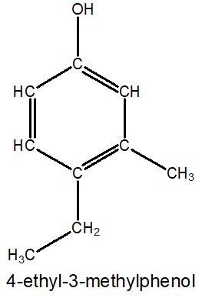
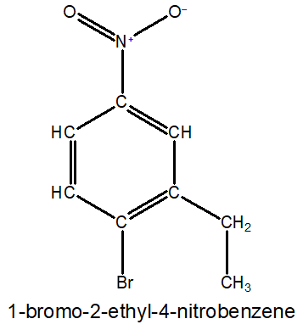
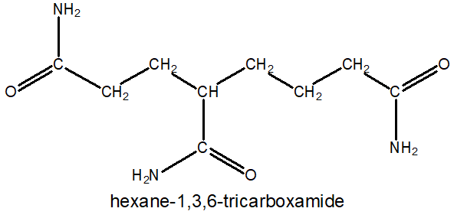

IUPAC Nomenclature of Cyclic Compounds
You will be able to name any organic compound as per IUPAC rules

Slide 3

Functional Group Containing Molecules
Molecules with functional groups:
1. Choose the longest carbon chain containing functional group (FG) as the parent chain.
2. The functional group (FG) must get a lowest number possible.
3. Remove ‘e’ from ane/ene/yne and add the name of the FG: → but-3-en-1-oicacid.
3. If a molecules contains more than one FG, one is chosen as principal FG and others as substituents.
4. If more than one identical FG present (except db/tb): full parent alkane’s name+o-di/tri/tetra-FG suffix
Functional groups prefix suffix
C11→ undec
C12→ dodec
C13→ tridec
C14→ tetradec
C15→ pentadec
C16→ hexadec
C17→ heptadec
C18→ octadec
C19→ nonadec
C20→ eicos
1. alkenes→ C-C: db
2. alkynes→ C-C: tb
1. Nitro→ -NO₂
2. Alkoxy→ -OR
3. Halo→ -X (F, Cl , Br,I)
- ene
- yne
nitro -
alkoxy -
halo -

Slide 4
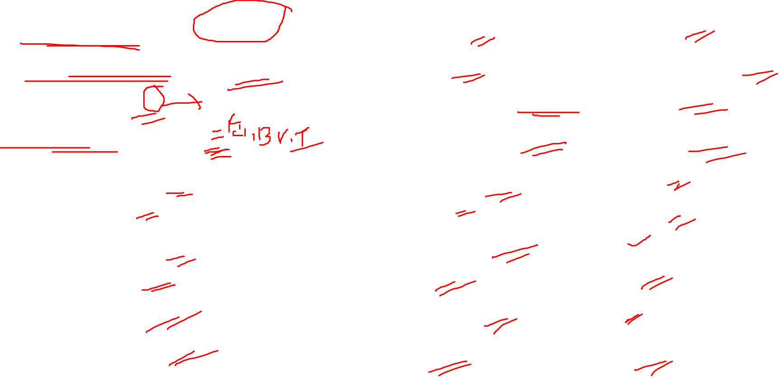
Functional Group Containing Molecules
functional groups prefix suffix
1. Carboxylic acid→ -COOH
1a. Sulphonic acid→ -SO₃H
1b. Ester→ -COOR
1c. Acid halide→ -COX
1d. Amide→ -CONH2
1e. Nitrile→ -CN
2. Aldehyde→ -CHO
3. Ketone→ -CO-
4. Alcohol→ -OH
5. Amine→ -NH₂
carboxy oic acid
sulpho sulphonic acid
Alkoxy carbonyl oate
halo carbonyl oyl halide
carbamoyl amide
cyano nitrile
formyl/oxo al
oxo one
hydroxy ol
amino amine

Slide 5
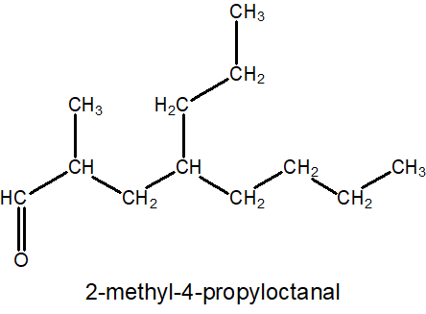
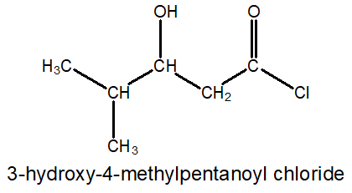
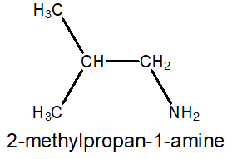
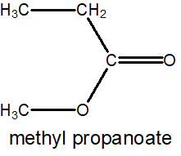
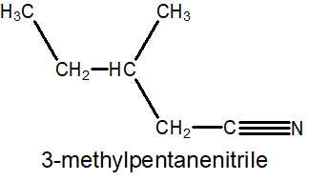
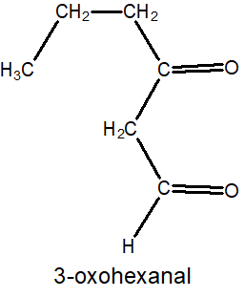
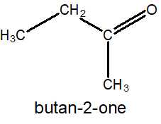
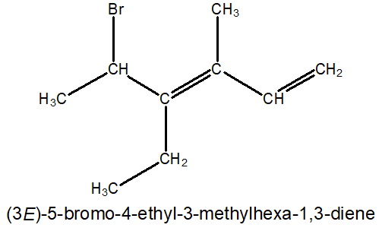
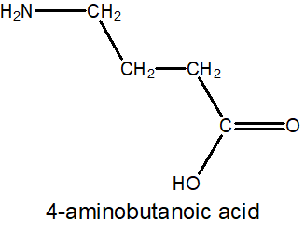
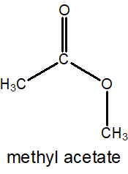
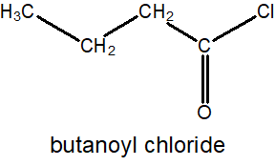
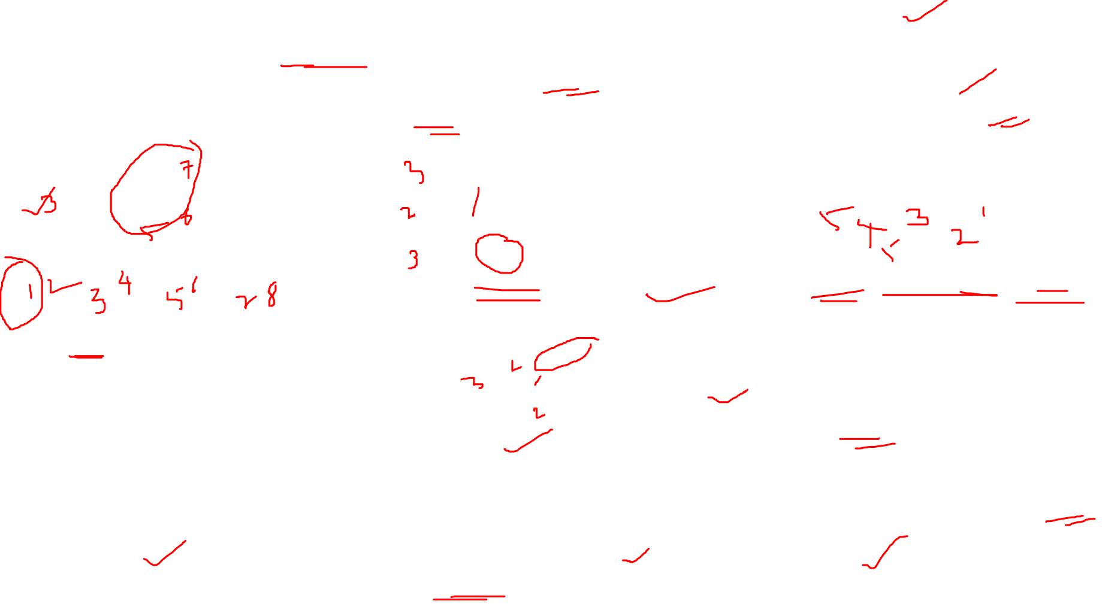
Molecules with functional groups:
1. Choose the longest carbon chain containing functional group (FG) as the parent chain.
2. The functional group (FG) must get a lowest number possible (except –OH, -CO-, -NH₂).
3. If FG suffix starts with→(a,i,o,u,y), then remove “e” of ane/ene/yne: → but-3-en-1-oicacid.
4. If a molecule contains more than one FG, one is chosen as principal FG and others as substituents.

Slide 6
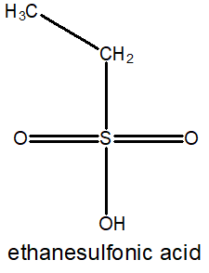
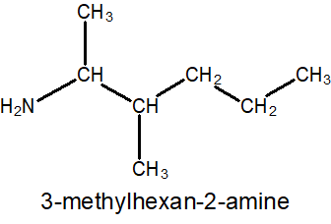
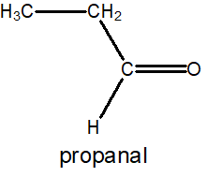
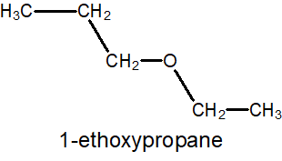
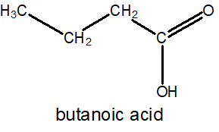
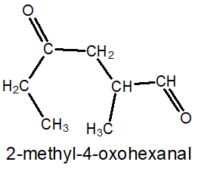
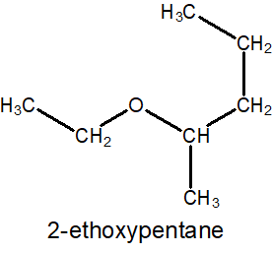
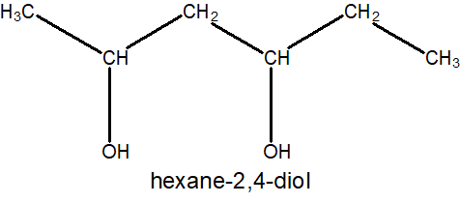
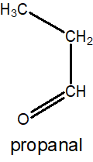
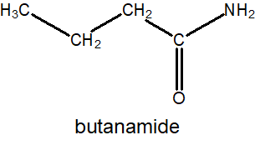
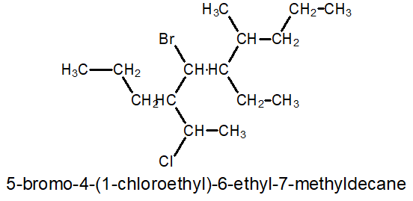
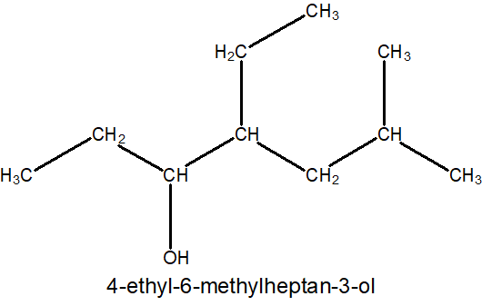
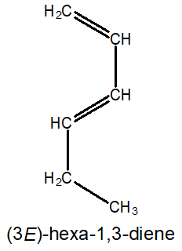
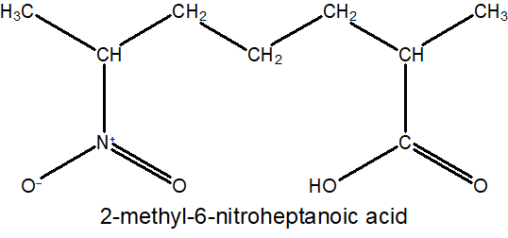

9
10
7
8
1
2
5
6
3
4

Slide 7
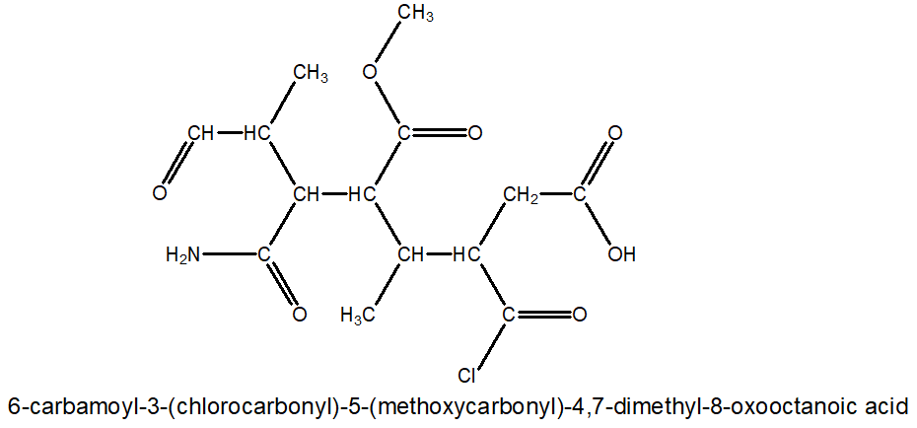
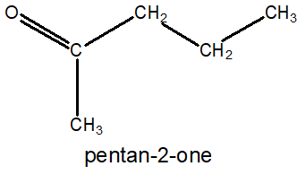
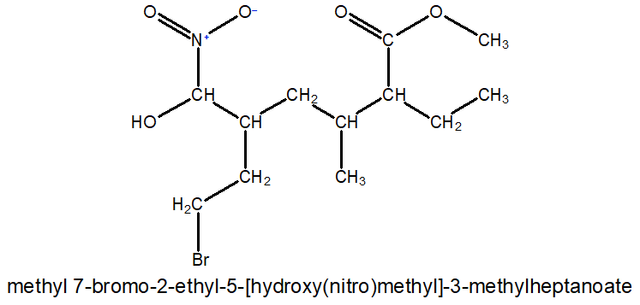
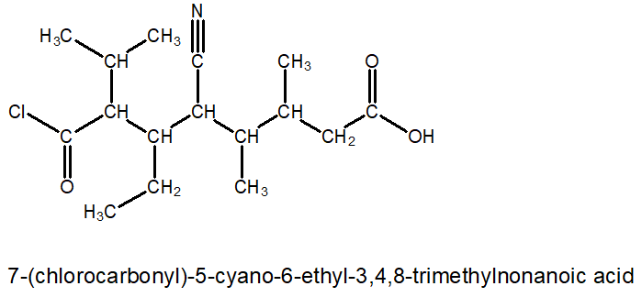
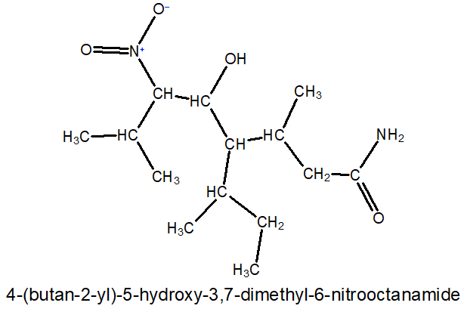
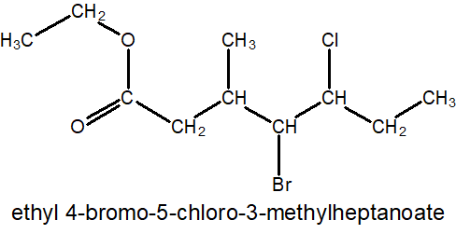

8
7
1
6
5
2
1
4
2
4
3
5
3
7
6
9
8
1
6
1
3
5
7
6
4
2
5
2
4
6
7
5
3
3
7
4
2
8
1

Slide 8
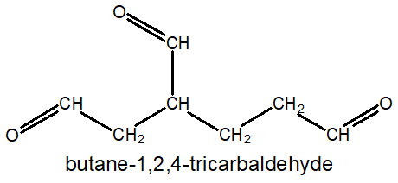
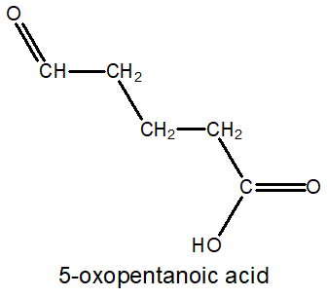
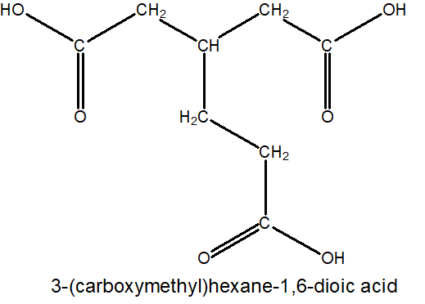
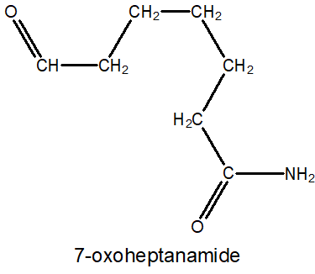
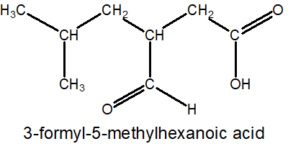
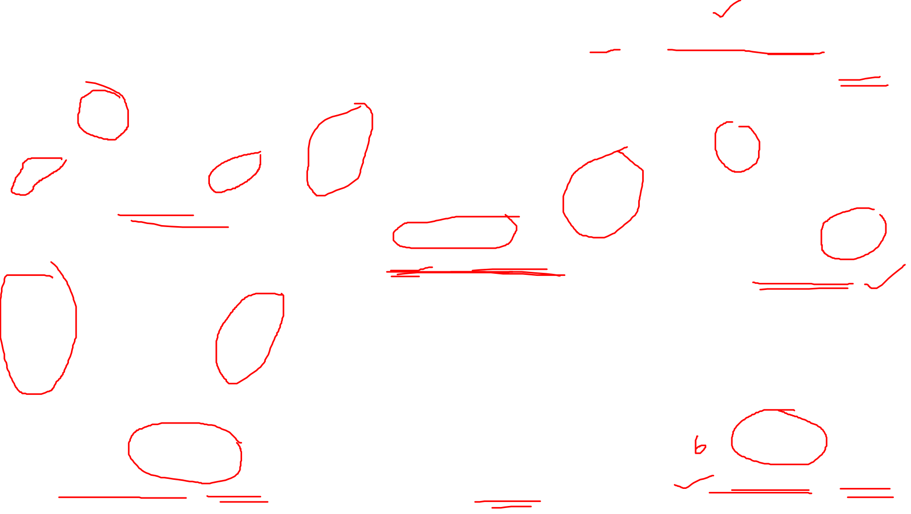
Molecules with functional groups:
5. Unbranched chain with 3/more same FGs→hexane-1,3,6-tricarboxylic acid.
6. Branched chain with 3/more same FG: Parent chain includes 2FG and 1FG as substituent.
7. If substituent is oxygen derivative of CH₃/CH₂: its carbon is also becoming part of parent chain.
2
4
2
4
6
5
4
1
3
1
3
5
3
2
1
2
1
3
5
4
7
6
3
6
4
2
4
5
3
1
5
2
6
1

Slide 9
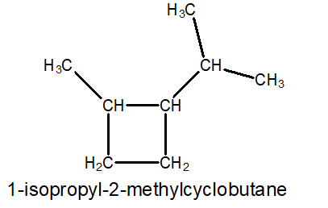
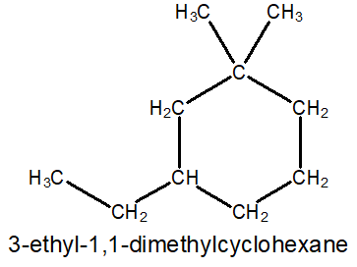
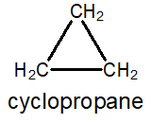
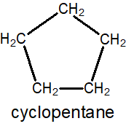
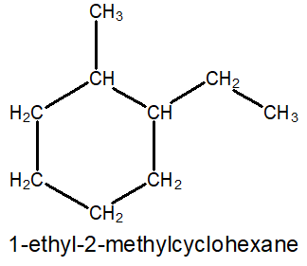
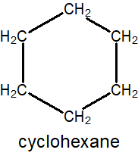
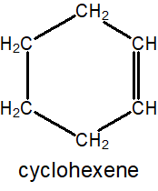
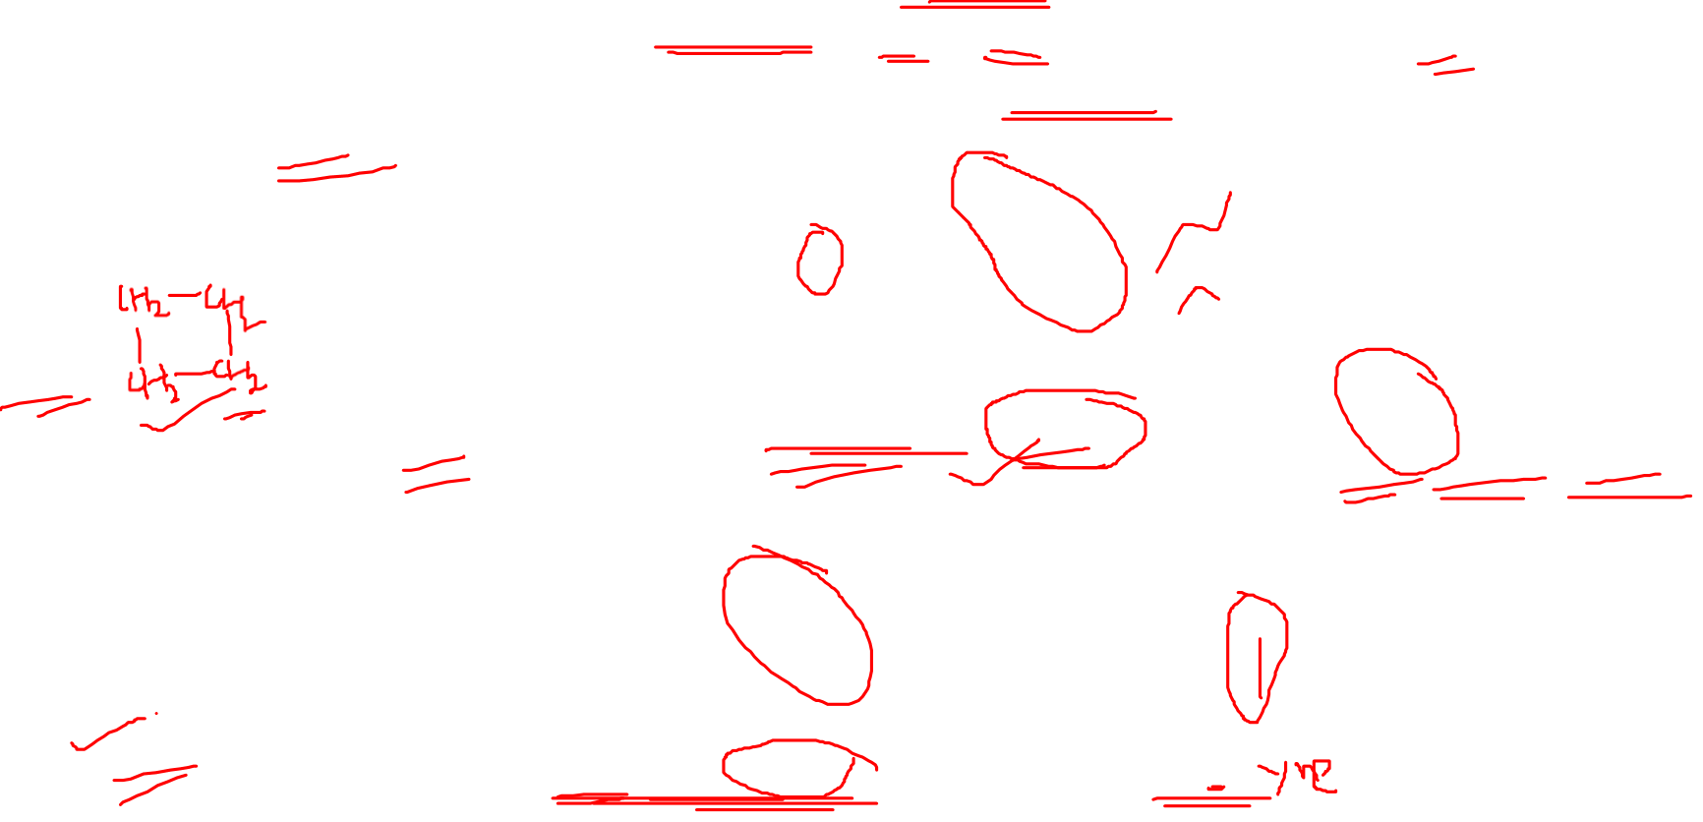
5. Alicyclic Compounds
Carbocyclic Compounds:
1. Add prefix “cyclo” before the equivalent alkane/alkene/alkyne chain.
2. Substituents numbering: priority to alphabetical order (ethyl>methyl)→ alkylcycloalkanes
3. C-Numbering: priority to carbon with more branched>carbon with less branches
4. Lowest set of locant rule
1
1
2
6
2
4
3
4
3
5
2
3
1
4
5
6

Slide 10








Carbocyclic Compounds:
5. Cycloalkane: attached alkyl group contains equal or a lower number of carbons than the cycloalkane.
6. Alkane: attached alkyl group contains more number of carbons than the cycloalkane (Ring→Sub).
7. Alkane: If the side chain consists of a functional group/multiple bonds (Ring→Sub).
8. Cycloalkenes/ynes: 1,2 number to the multiple bond, path→substituent gets lower number possible.
3
2
3
4
2
1
4
5
6
1
5
1
2
1
6
2
3
4
4
2
3
3
5
1
5
1
3
4
2
6

Slide 11









6. Benzene Aromatic Compounds
Aromatic Benzenoid Compounds:
1. Base name is ‘benzene’ and “Sub+benzene”.
2. Lowest number to the substituent and is a prefix to the ‘benzene’.
3. If 2/more substituents: “lowest set of locant rule”
4. Assign numbers to substituents in alphabetical order.
3
2
1
4
5
6
1
6
2
4
3
5
1
1
6
4
6
2
2
5
3
3
5
3
5
4
6
2
4
1

Slide 12





Aromatic Benzenoid Compounds:
5. If FG is present in the branch, benzene becomes substituent (phenyl).
6. Subs/branches locants to be written same as in alphabetical order before.
4
2
5
3
1
5
3
1
4
2
4
5
3
6
2
1

Slide 13

IUPAC Advanced Course: Review
Molecules with Functional Groups:
1. Choose the longest carbon chain containing functional group (FG) as parent chain.
2. The functional group (FG) must get a lowest number possible (except –OH, -CO-, -NH₂).
3. If FG suffix starts with→(a,i,o,u,y), then remove “e” of ane/ene/yne: → → but-3-en-1-oicacid.
4. If a molecules contains more than one FG, one is chosen as principal FG and others as substituents.
5. Unbranched chain with 2/more same FG→ alkane-1,3,6-hexane tricarboxylic acid.
6. Branched chain with 2/more same FG: Parent chain includes 2FG and 1FG as substituent.
7. If substituent is oxygen derivative of CH₃/CH₂: its carbon is also becoming part of parent chain.
Carbocyclic Compounds (Alicyclic):
1. Add prefix “cyclo” before the equivalent alkane/alkene/alkyne chain.
2. Substituents numbering: priority to alphabetical order (ethyl>methyl)→ alkylcycloalkanes
3. C-Numbering: priority to carbon with more branched>carbon with less branches
4. Lowest set of locant rule
5. Cycloalkane: attached alkyl group contains equal or a lower number of carbons than the cycloalkane.
6. Linear Alkane: attached alkyl group contains more number of carbons than the cycloalkane (Ring→S).
7. Linear Alkane: If the side chain consists of a functional group/multiple bonds (Ring→S)
8. Cycloalkenes/ynes: 1,2 number to the multiple bond, substituent gets lower number possible.
Aromatic Benzenoid Compounds:
1. Base name is ‘benzene’
2. Lowest number to the substituent/FG and is a prefix to the ‘benzene’.
3. If 2/more substituents: “lowest set of locant rule”
4. Assign numbers to substituents in alphabetical order.
5. If FG is present in the branch, benzene becomes substituent (phenyl).
Notes:
If chains of equal length are competing for selection as the parent chain, then the choice goes in series to: a) the chain which has the greatest number of side chains. b) the chain whose substituents have the lowest- numbers. c) the chain having the greatest number of carbon atoms in the smaller side chain. d)the chain having the least branched side chains.
SOURCE;
http://www.chem.uiuc.edu/GenChemReferences/nomenclature_rules.html

Slide 14







PRACTICE
1
2
3
4
5
6
Notes:
SOLUTIONS:-
1. 1-ethyl-3,5-diemthylbenzene
2. 4-ethyl-2-methylhexa-1,3-dien-5-yne
3. 3-(cyclopentylmethyl)-2-methylpentanal
4. ethylcyclopropane
5. 6-amino-7-bromo-4-chloro-8-methyl-5-nitro-2-isopropylnonamide
6. 5-carbamoyl-6-chlorocarbonyl-4-ethyloctanoic acid

Slide 15






PRACTICE
9
7
8
10
11
12
Notes:
SOLUTIONS:-
7. ethyl 2-methylpentanoate
8. 1-ethoxypropane
9. 4-ethyl-3-methylaniline
10. 3-carbamoyl-5-formyl-4,7-dimethyl-6-nitrooctanoic acid
11. methyl 6-ethyl-3,4-dimethylnonaoate
12. 2-(cyclopent-3-en-1yl)butanal

